Slide 1
Team 1: Empowering Learners with AI
Ana N., Cecilia W., Jenny L., Vivi M.

Slide 2
Agenda
Intro
Needfinding Results + Insights
POVs & HMWs
Solutions
Experience Prototypes
What’s Next
Appendix

Slide 3
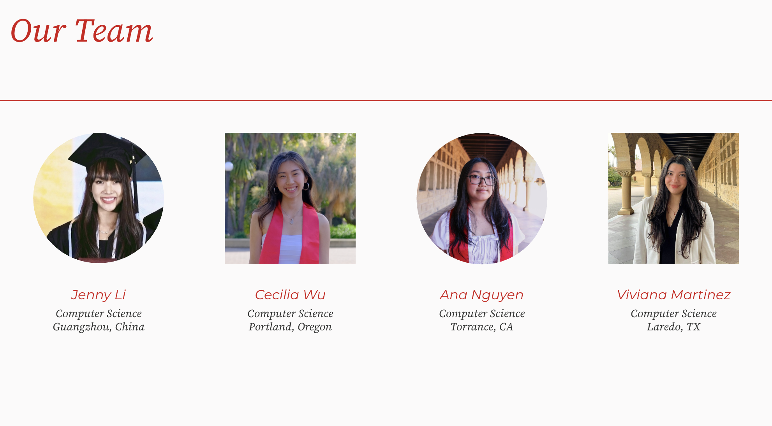

Slide 4
Domain
Self-Learning
Career Transitions
Collaboration
Engagement
Retention
Collaboration
Encouragement
Notes:
online

Slide 5
Needfinding Results

Slide 6
Interviewees
Early 50s
Accomplished
Woman
35-yo private chef
Mid-30s male entrepreneur
“Bale”
“Laura”
Aerospace executive
Lifelong learner
“Chai”
Currently seeking for jobs
Private chef working in Palo Alto
Extreme User
Notes:
He went from college to startups to real estate then took a step back to go back to school (and now he’s kinda trying to land a tech job)

Slide 7
Questions
What inspired you to make the transition from previous field to current role?
What steps did you take to prepare the transition? (e.g., courses, networking, side projects)
Which skills from your previous career helped you the most in your new role?
Did you have mentors or peers who supported you through the transition? How did you find them?
What was the hardest part of the transition?
Notes:
Motivation
Transition Process
Transferable skills
Mentorship & Support
Reflection

Slide 8
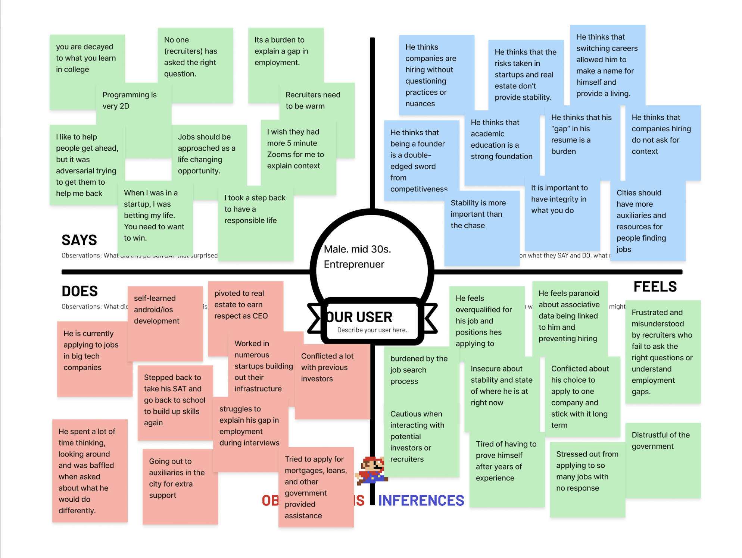
Mid-30s
Entrepreneur

Slide 9
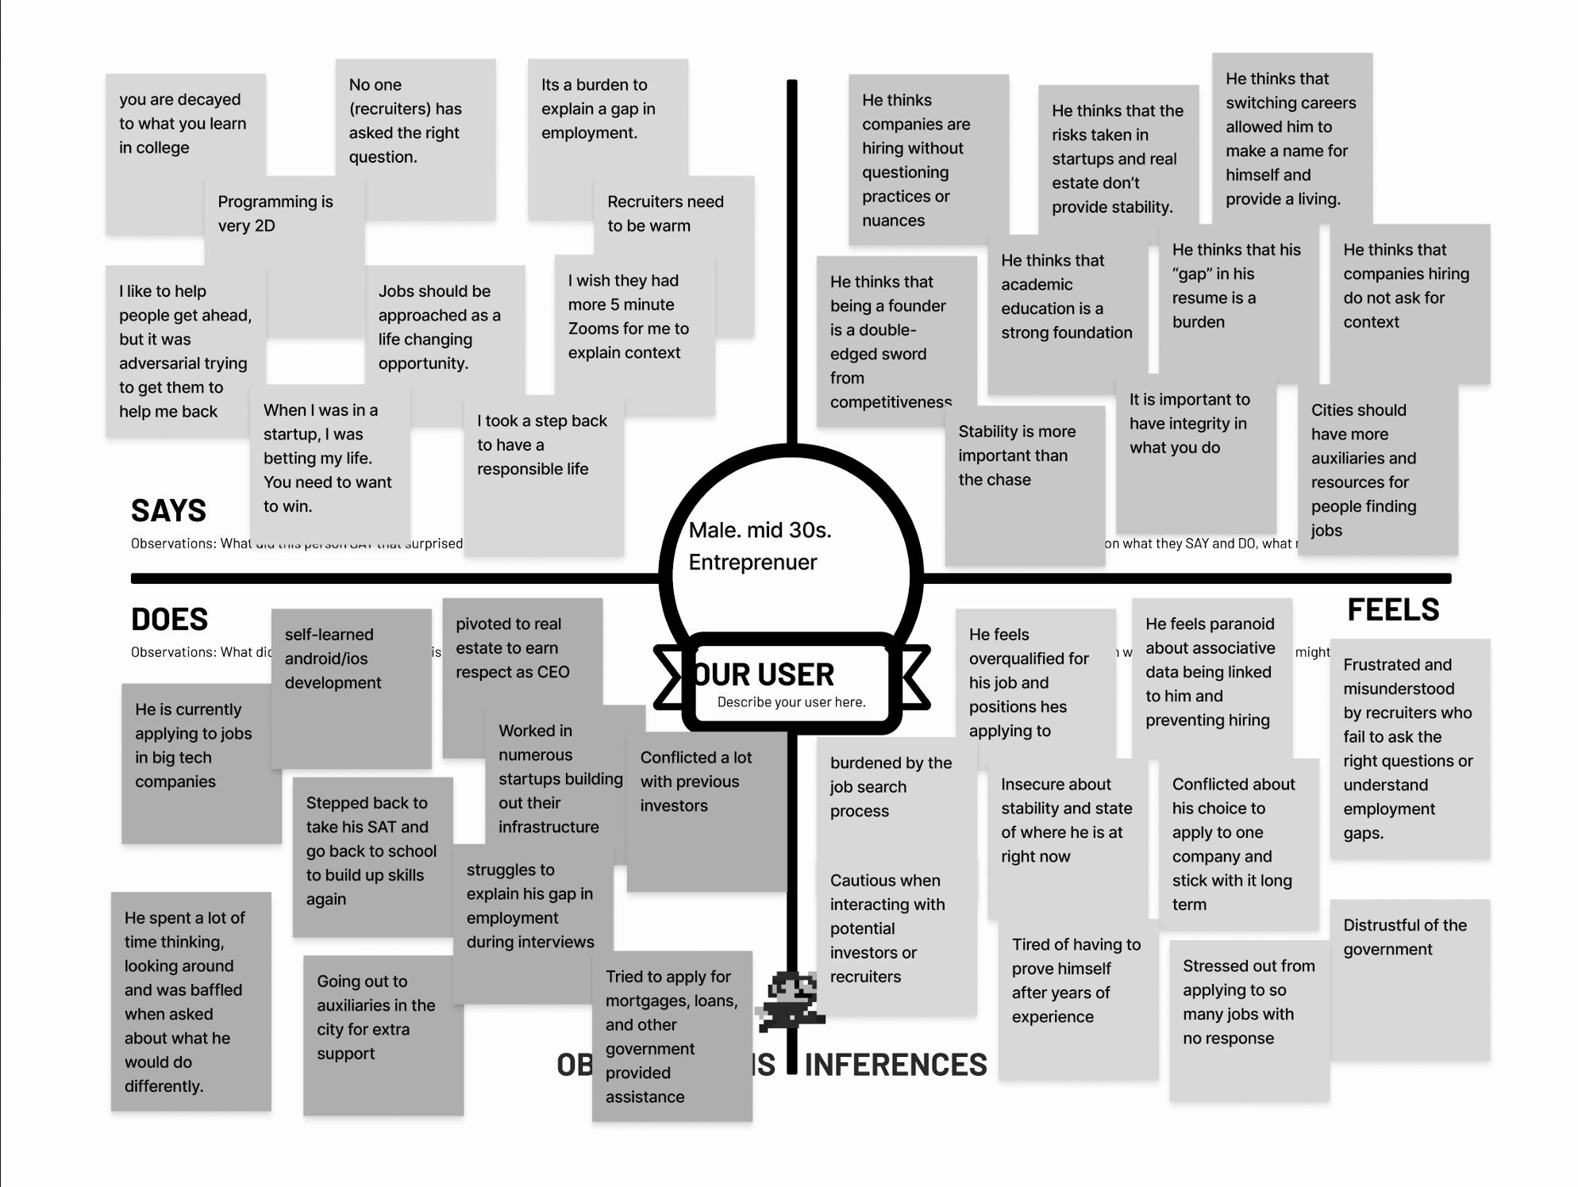
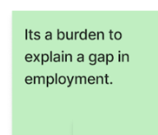
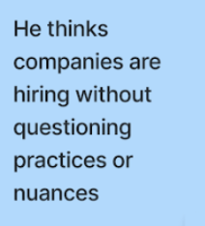
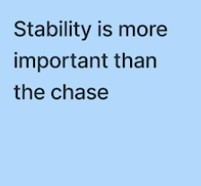
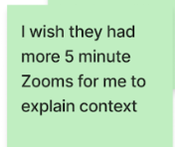
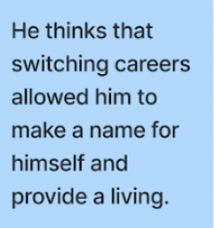
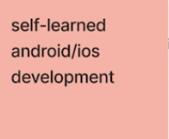
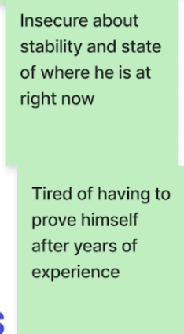
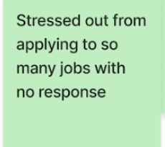
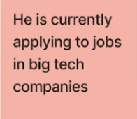
Mid-30s Entrepreneur

Slide 10
Insights & Needs
Ambition vs. Stability
Struggles with Hiring Systems & Recruiters
Emotional Burden & Distrust
Desire for Human Connection and Guidance
Notes:
Startup -> big tech, (risks vs. security)
3. Paranoid
4. Mentorship

Slide 11
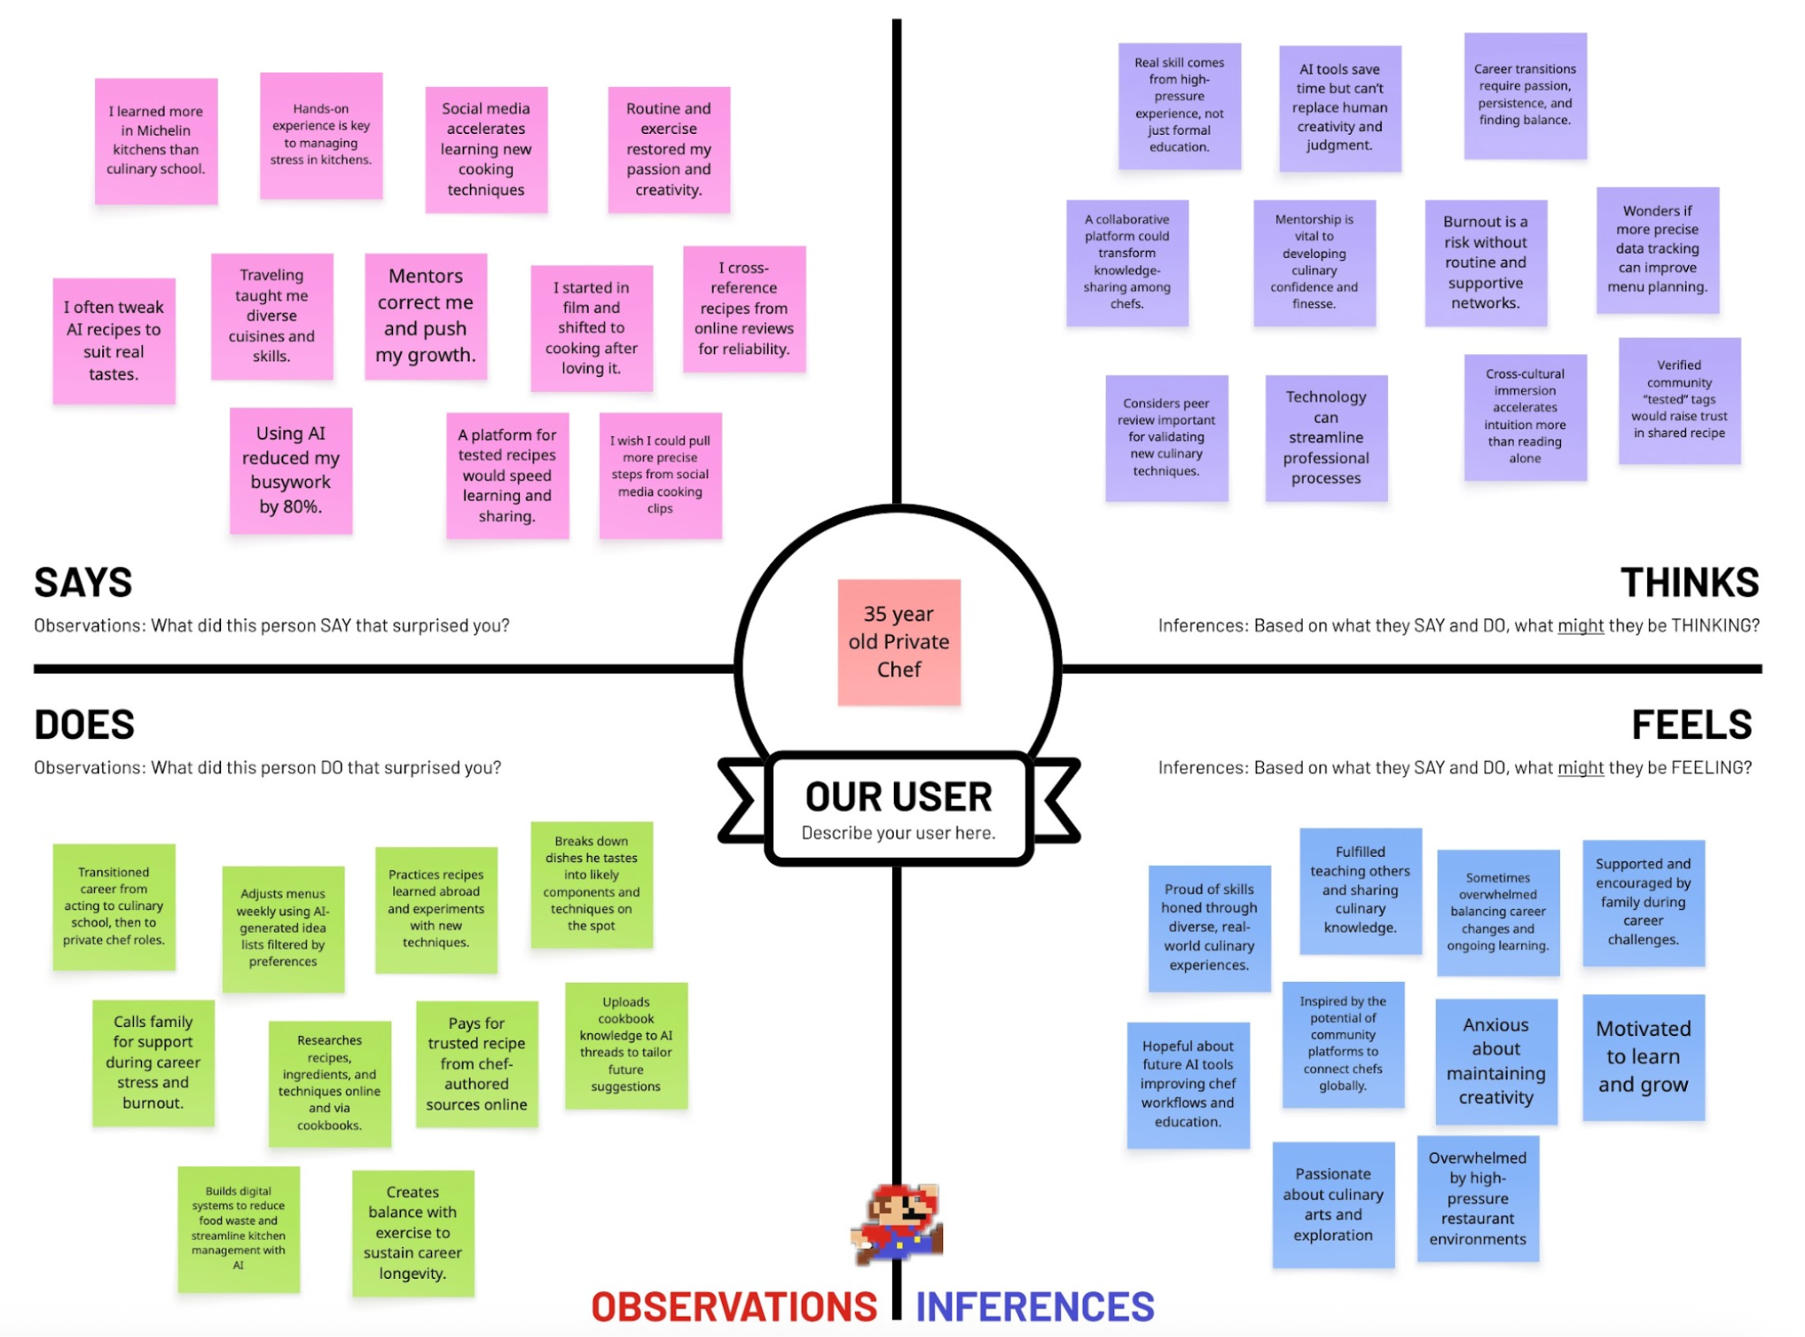
35-yo Private Chef
Notes:
Started from film and shifted to cooking => love it
Hands-on experience (travel)

Slide 12
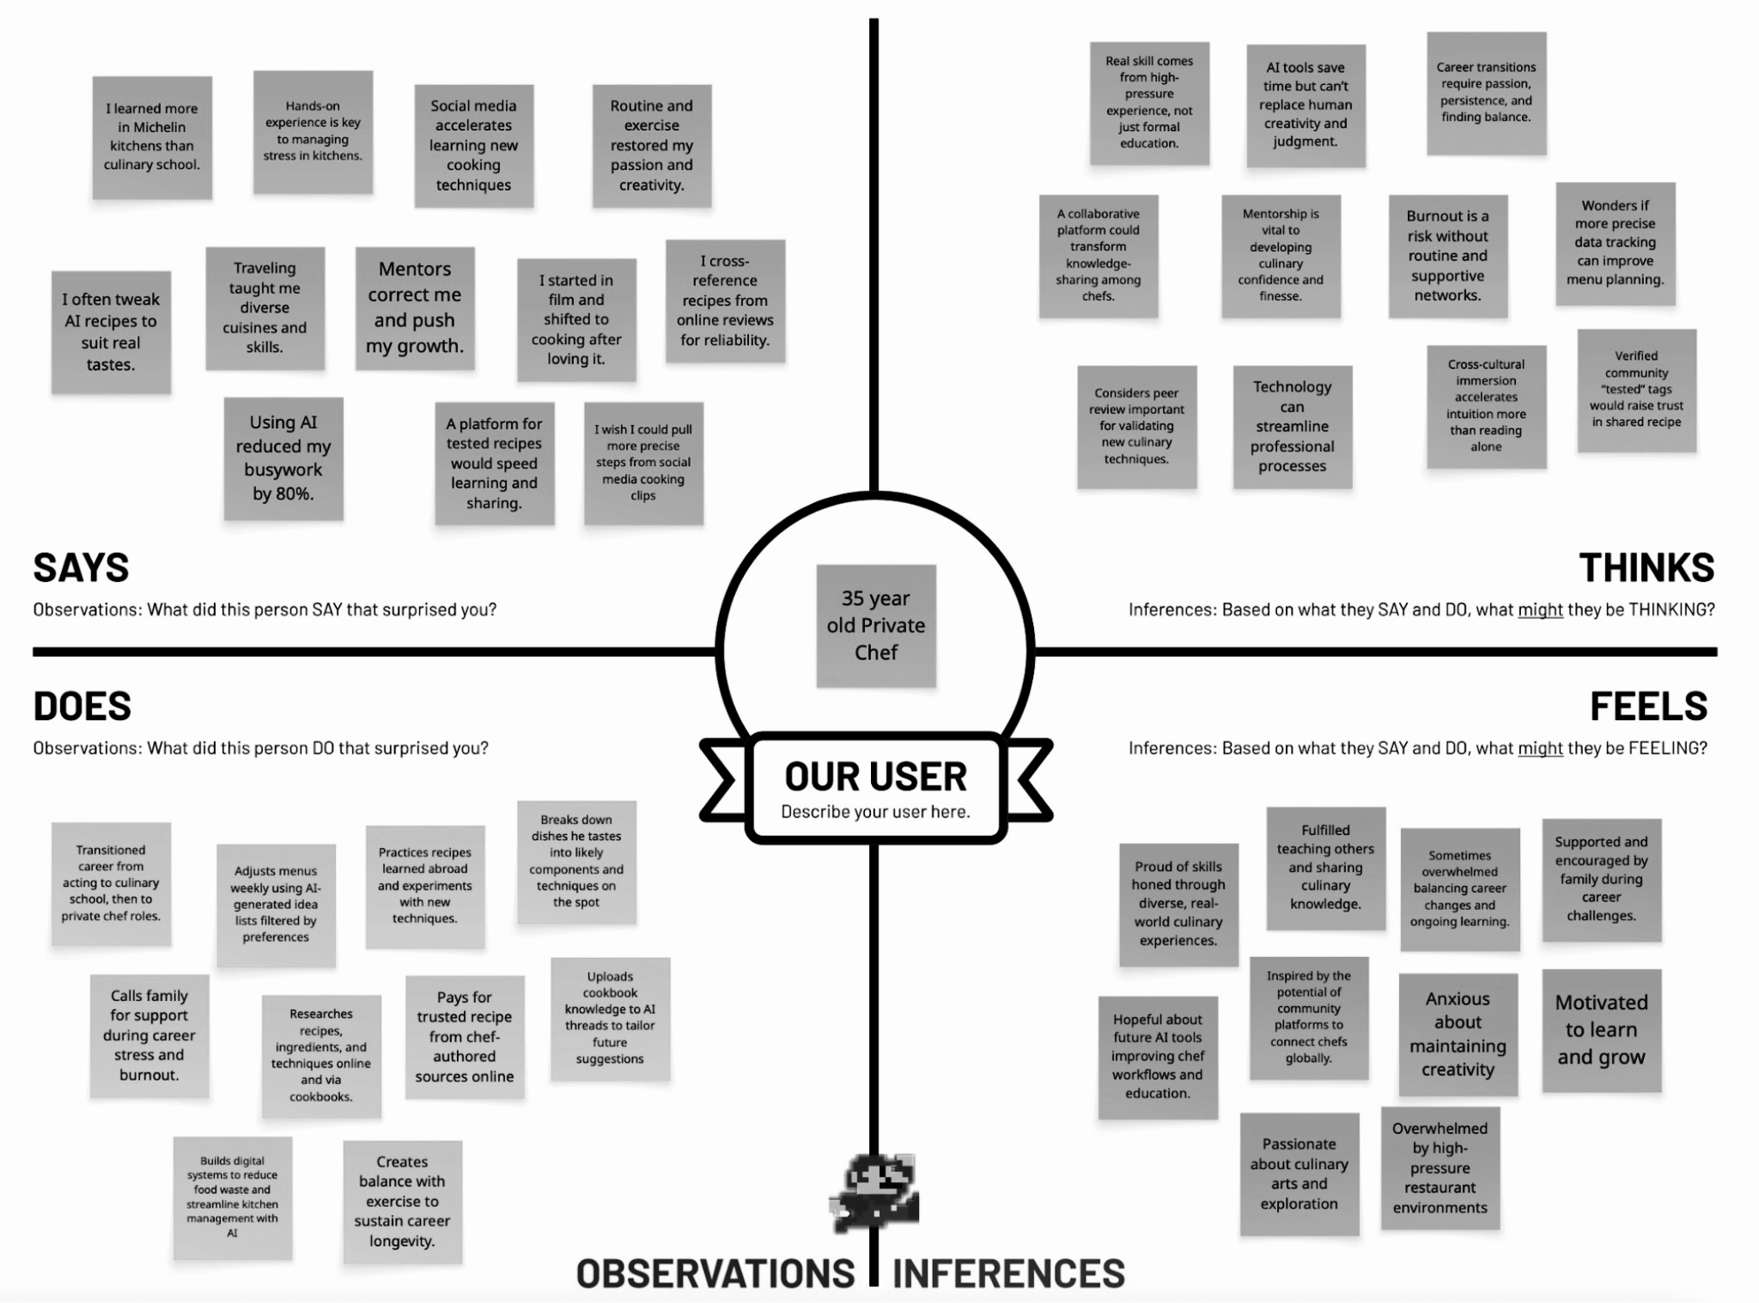
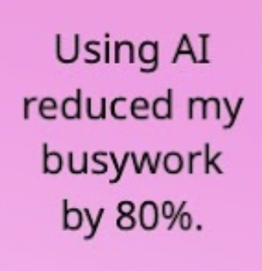
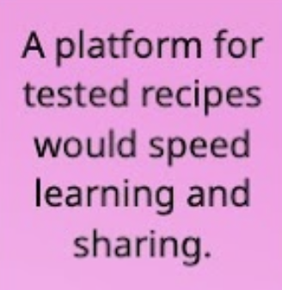
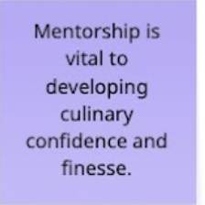
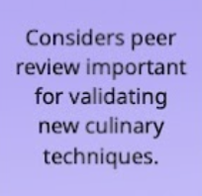
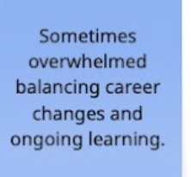
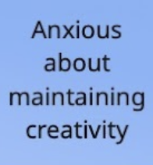
35-yo Private Chef

Slide 13
Insights & Needs
Career transition fueled by passion and persistence
Learn through Experience and Community
Human judgement is still central despite AI integration
Notes:
Hawaii -> Worked at michelin resturant -> family chef (rotational)
2. He values mentorship, cross-cultural immersion, and peer review over traditional education.
He believes “a collaborative platform could transform knowledge-sharing among chefs.”
3. Human experience & judgement can’t be replace

Slide 14
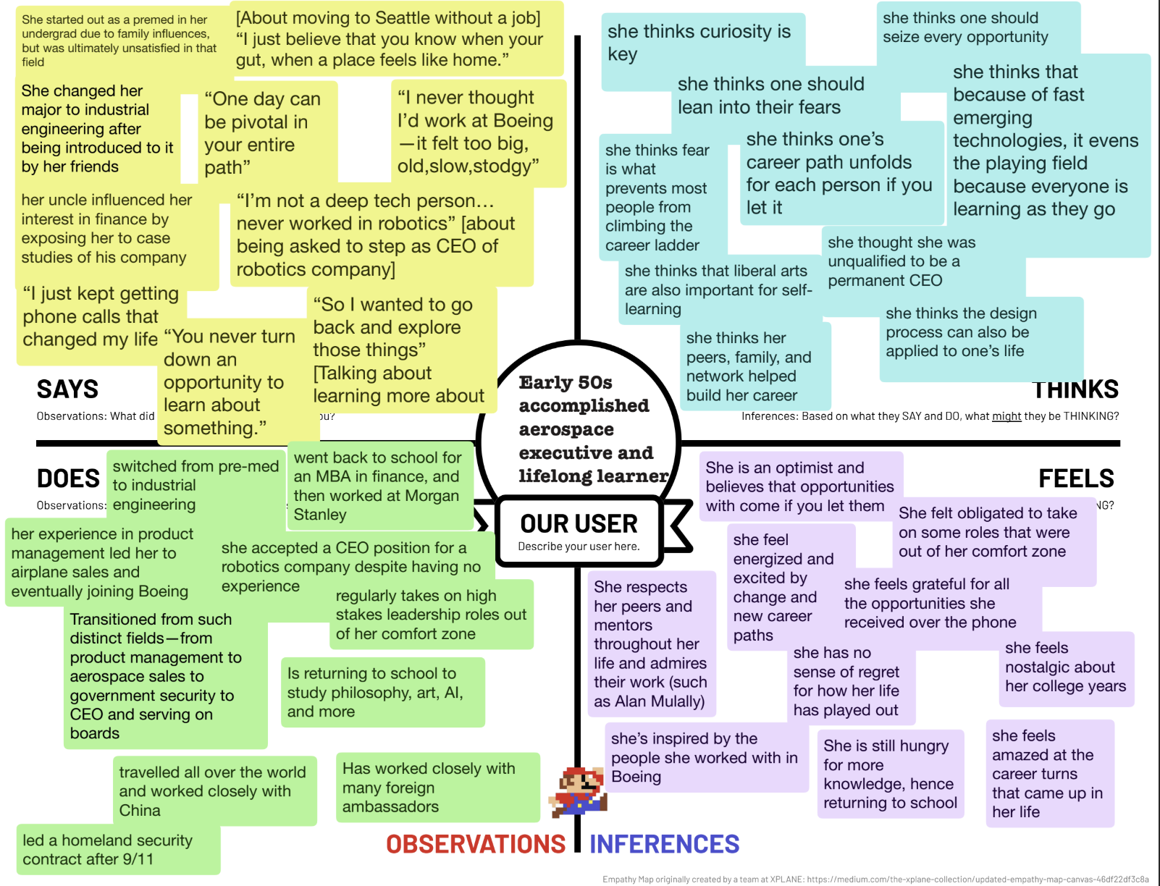
Accomplished aerospace executive
Notes:
Read does

Slide 15
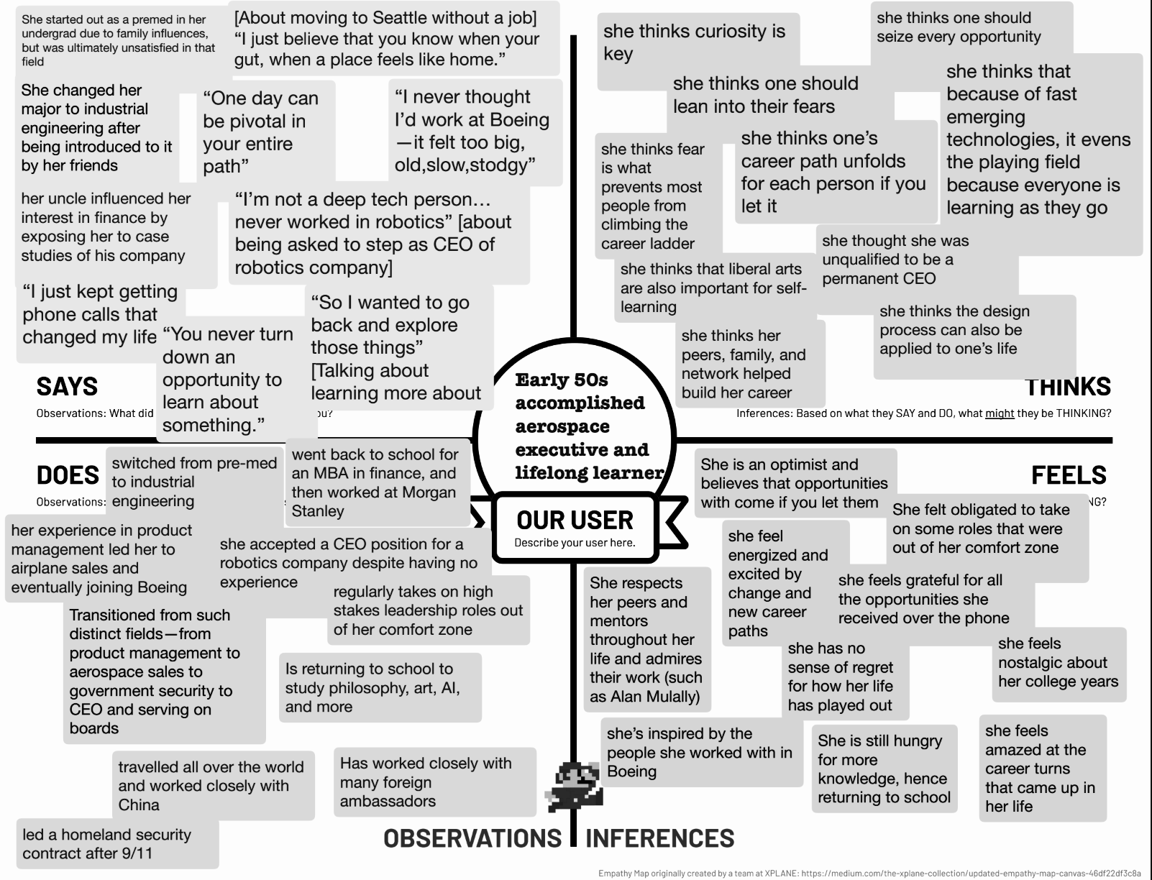
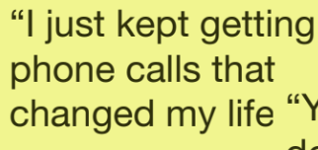
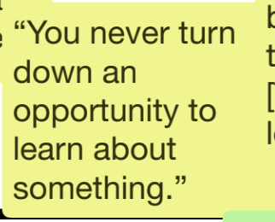
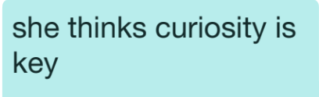
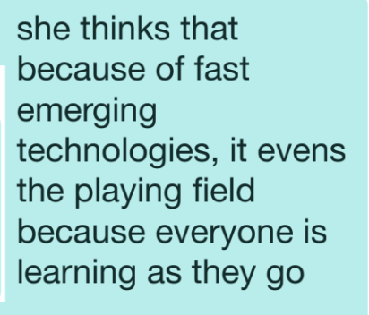
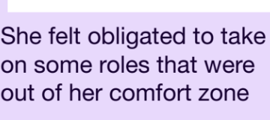
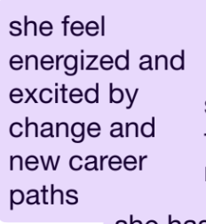
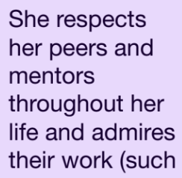
Accomplished aerospace executive
Notes:
Read does

Slide 16
Insights & Needs
Curiosity & Continuous Learning
Fearless toward Uncertainty
Belief in Cross-Disciplinary Thinking
Notes:
2. Our of her comfort zone
3. Philosophy, AI ethics, liberal arts, robotics

Slide 17
POVs & HMWs

Slide 18
We met a 30-year-old man who studied film & acting in college and is currently a private chef in Palo Alto.
POV 1: Private Chef Interview
We were surprised to notice that he switched to a totally different career after college.
We wondered if this means people are redefining “career success” not as sticking to one path, but as pursuing creativity across fields.
HMW use his experience to help others who are in the same situation?
It would be game-changing if we could celebrate and connect people with nonlinear career journeys.

Slide 19
HMW: Private Chef
Notes:
HMW help him find out that he wasn’t interested in film in the early stage?
HMW help him with the transition into his next job?
HMW make film & acting more interesting for him?
HMW use his experience to help others who are in the same situation?
HMW highlight how his past experience and skills (e.g., film and acting) help his cooking and presentation as a chef?
HMW help him explore multiple careers at the same time?
HMW connect him with local filmmakers or visual artists to produce a food-focused docuseries?
HMW treat every dish like a short film for him?
HMW help him scale his private chef work into a brand?
HMW help him find more clients who appreciate storytelling in food?

Slide 20
We met a mid-30s entrepreneur who transitioned from tech startups to real estate and is now returning to college.
POV 2: Entrepreneur Interview
We were surprised that despite his strong skills and experience, he feels frustrated that recruiters don’t ask the right questions and wishes for more personal, five-minute conversations.
We wonder if this means he feels unseen and burdened by having to justify his employment gap rather than being valued for his experience.
HMW help mid-career professionals translate their past work into new contexts?
It would be game-changing if he could feel recognized and confident in his background, without anxiety about how others perceive his career transitions.

Slide 21
HMW: Entrepreneur Interview
Notes:
HMW make an employment gap feel like an asset and strength rather than a burden?
HMW help him not care about others’ perceptions?
HMW introduce more confidence about his background?
HMW simulate more personal, conversations?
HMW make him feel seen during the recruiting process?
HMW help him transition his career without needing to mention his employment gap?
HMW create spaces for authentic conversations between candidates and recruiters?
HMW reframe interviews as storytelling moments instead of interrogations?
HMW create communities or mentorship programs for career shifters?
HMW help mid-career professionals translate their past work into new contexts?
HMW provide emotional or peer support to navigate uncertainty in transitions?
HMW celebrate risk-taking and experimentation in one’s career journey?
HMW make returning to school feel like a strength that enhances employability?

Slide 22
We met an early 50s well-accomplished board executive and lifelong learner who has worked in PM, aerospace sales, finance, and robotics.
POV 3: Board Executive Interview
We were surprised to notice that many of her most meaningful career shifts began with spontaneous moments, like a single phone call, that she embraced without overanalyzing.
We wonder if this means that career growth and self-fulfillment can come from serendipitous opportunities rather than a pre-planned trajectory.
HMW encourage people to say YES to more opportunities out of their comfort zone?
It would be game-changing if people felt seen and confident in trusting these moments of serendipity rather than uncertainty and empowered to recognize and respond to unexpected opportunities, without anxiety about deviating from a conventional career trajectory.

Slide 23
HMW: Executive Board Interview
Notes:
HMW help him find out that he wasn’t interested in film in the early stage?
HMW help him with the transition into his next job?
HMW make film & acting more interesting for him?
HMW use his experience to help others who are in the same situation?
HMW highlight how his past experience and skills (e.g., film and acting) help his cooking and presentation as a chef?
HMW help him explore multiple careers at the same time?
HMW connect him with local filmmakers or visual artists to produce a food-focused docuseries?
HMW treat every dish like a short film for him?
HMW help him scale his private chef work into a brand?
HMW help him find more clients who appreciate storytelling in food?

Slide 24
Solutions

Slide 25
Solution #1
Match users with peers who also want to take more risks. They hold each other accountable for saying yes to new things and share reflections afterward. Builds social reinforcement and reduces fear of failure. Framed as challenge event with friends that draw a “dare” and have to do it all together.

Slide 26
Solution #2
Turn past experiences into podcast episodes. People record their personal life/work experiences and post it onto a feed for other strangers to listen to, respond or relate to, so they don’t feel alone in their journey. AI can turn it into easily digestible podcast episodes that people can listen to on the move.

Slide 27
Solution #3
Create a platform where people can shadow each other’s days in their target field by offering in-person shadow session scheduling or virtually stepping into someone else’s shoes.

Slide 28
Experience Prototypes

Slide 29
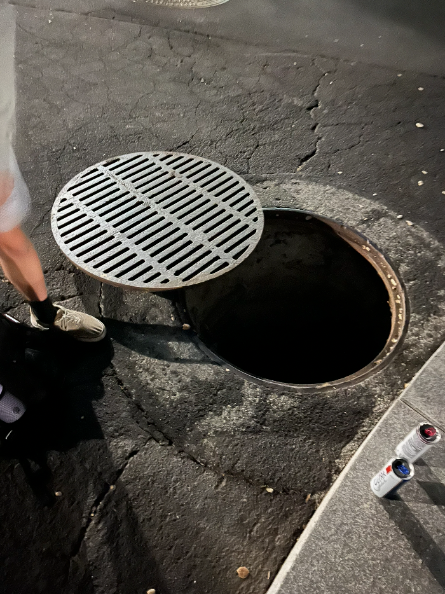
Assumption #1
Participant: Ana’s club mate
Assuming that social reinforcement and peer accountability effectively motivate individuals to take more risk.
Test: Asked someone to do something that they’ve always wanted to do but never did it.
Notes:
go through the tunnel by the fountain at the roundabout next to gates to memorial church

Slide 30
Assumption #1
WHY: Many people want to try new experiences but rarely act on them alone due to fear of failure or judgement. However, when risk-taking is shared, especially with friends or peers who are also stepping out of their comfort zones, the fear becomes manageable and even exciting.
Notes:
We wanted to test whether structured, gamified accountability (like a “dare draw” challenge) could help people turn intention into action and make risk-taking feel socially rewarding rather than intimidating.
Roles: Person A (initiator): Tells a challenge that she has always wanted to do.
Person B (peer partner): Joins the initiator in completing the challenge.
ENVIRONMENT: The challenge took place at school, in a casual and comfortable setting.

Slide 31
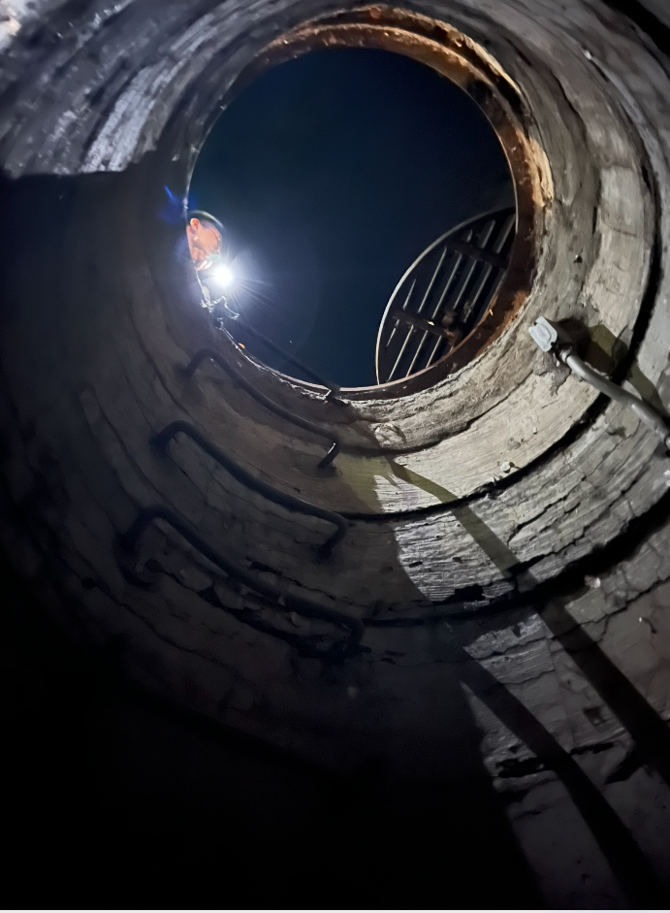
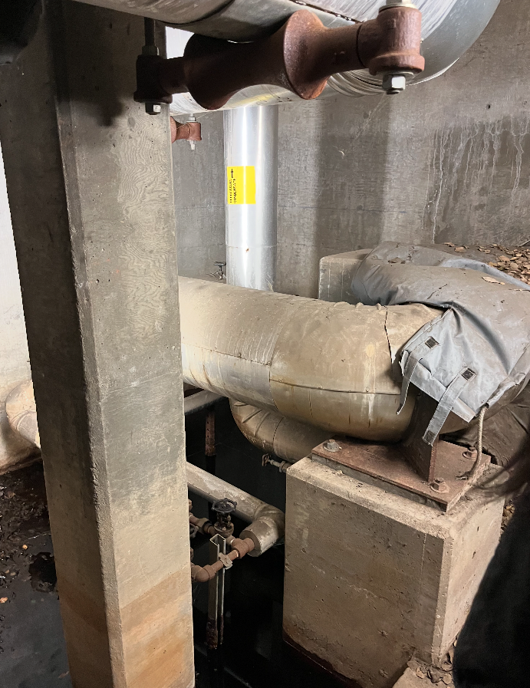
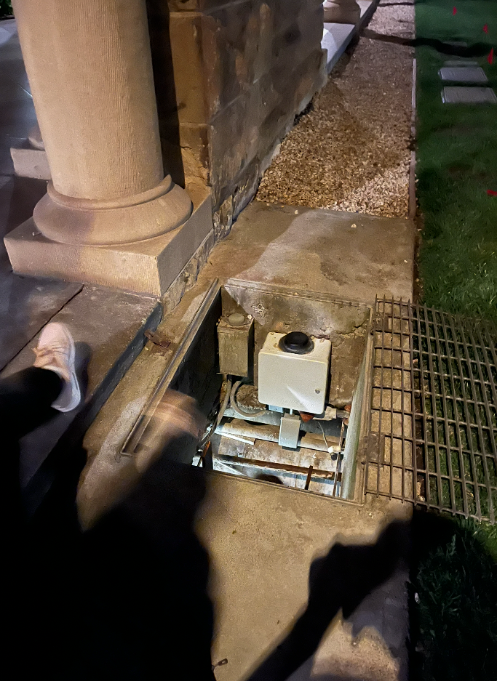

Slide 32
Assumption #2
People are comfortable sharing their personal stories to strangers.
WHY: In conversation, we found that people often open up when they realize others have gone through similar experiences. We wanted to explore whether this willingness to share could extend to a public platform, especially if the goal was to help others feel less alone. By having two strangers share stories with each other, we wanted to observe if people agreed to share a story, how awkward it felt (resistance to start), and how much depth they gave.
Notes:
Roles: Person A - us. We record a story and share it to a stranger anonymously and ask them to record a story after hearing ours. Person B - stranger that listens and then records story if opts in.

Slide 33

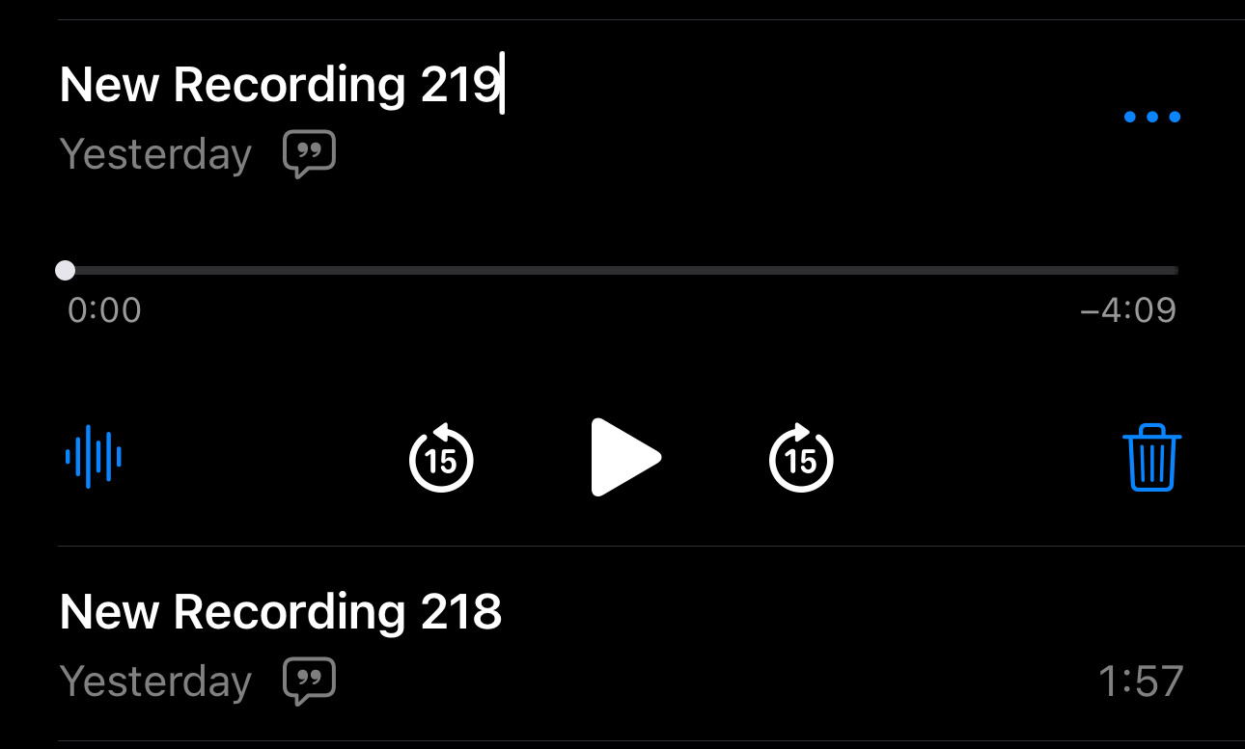
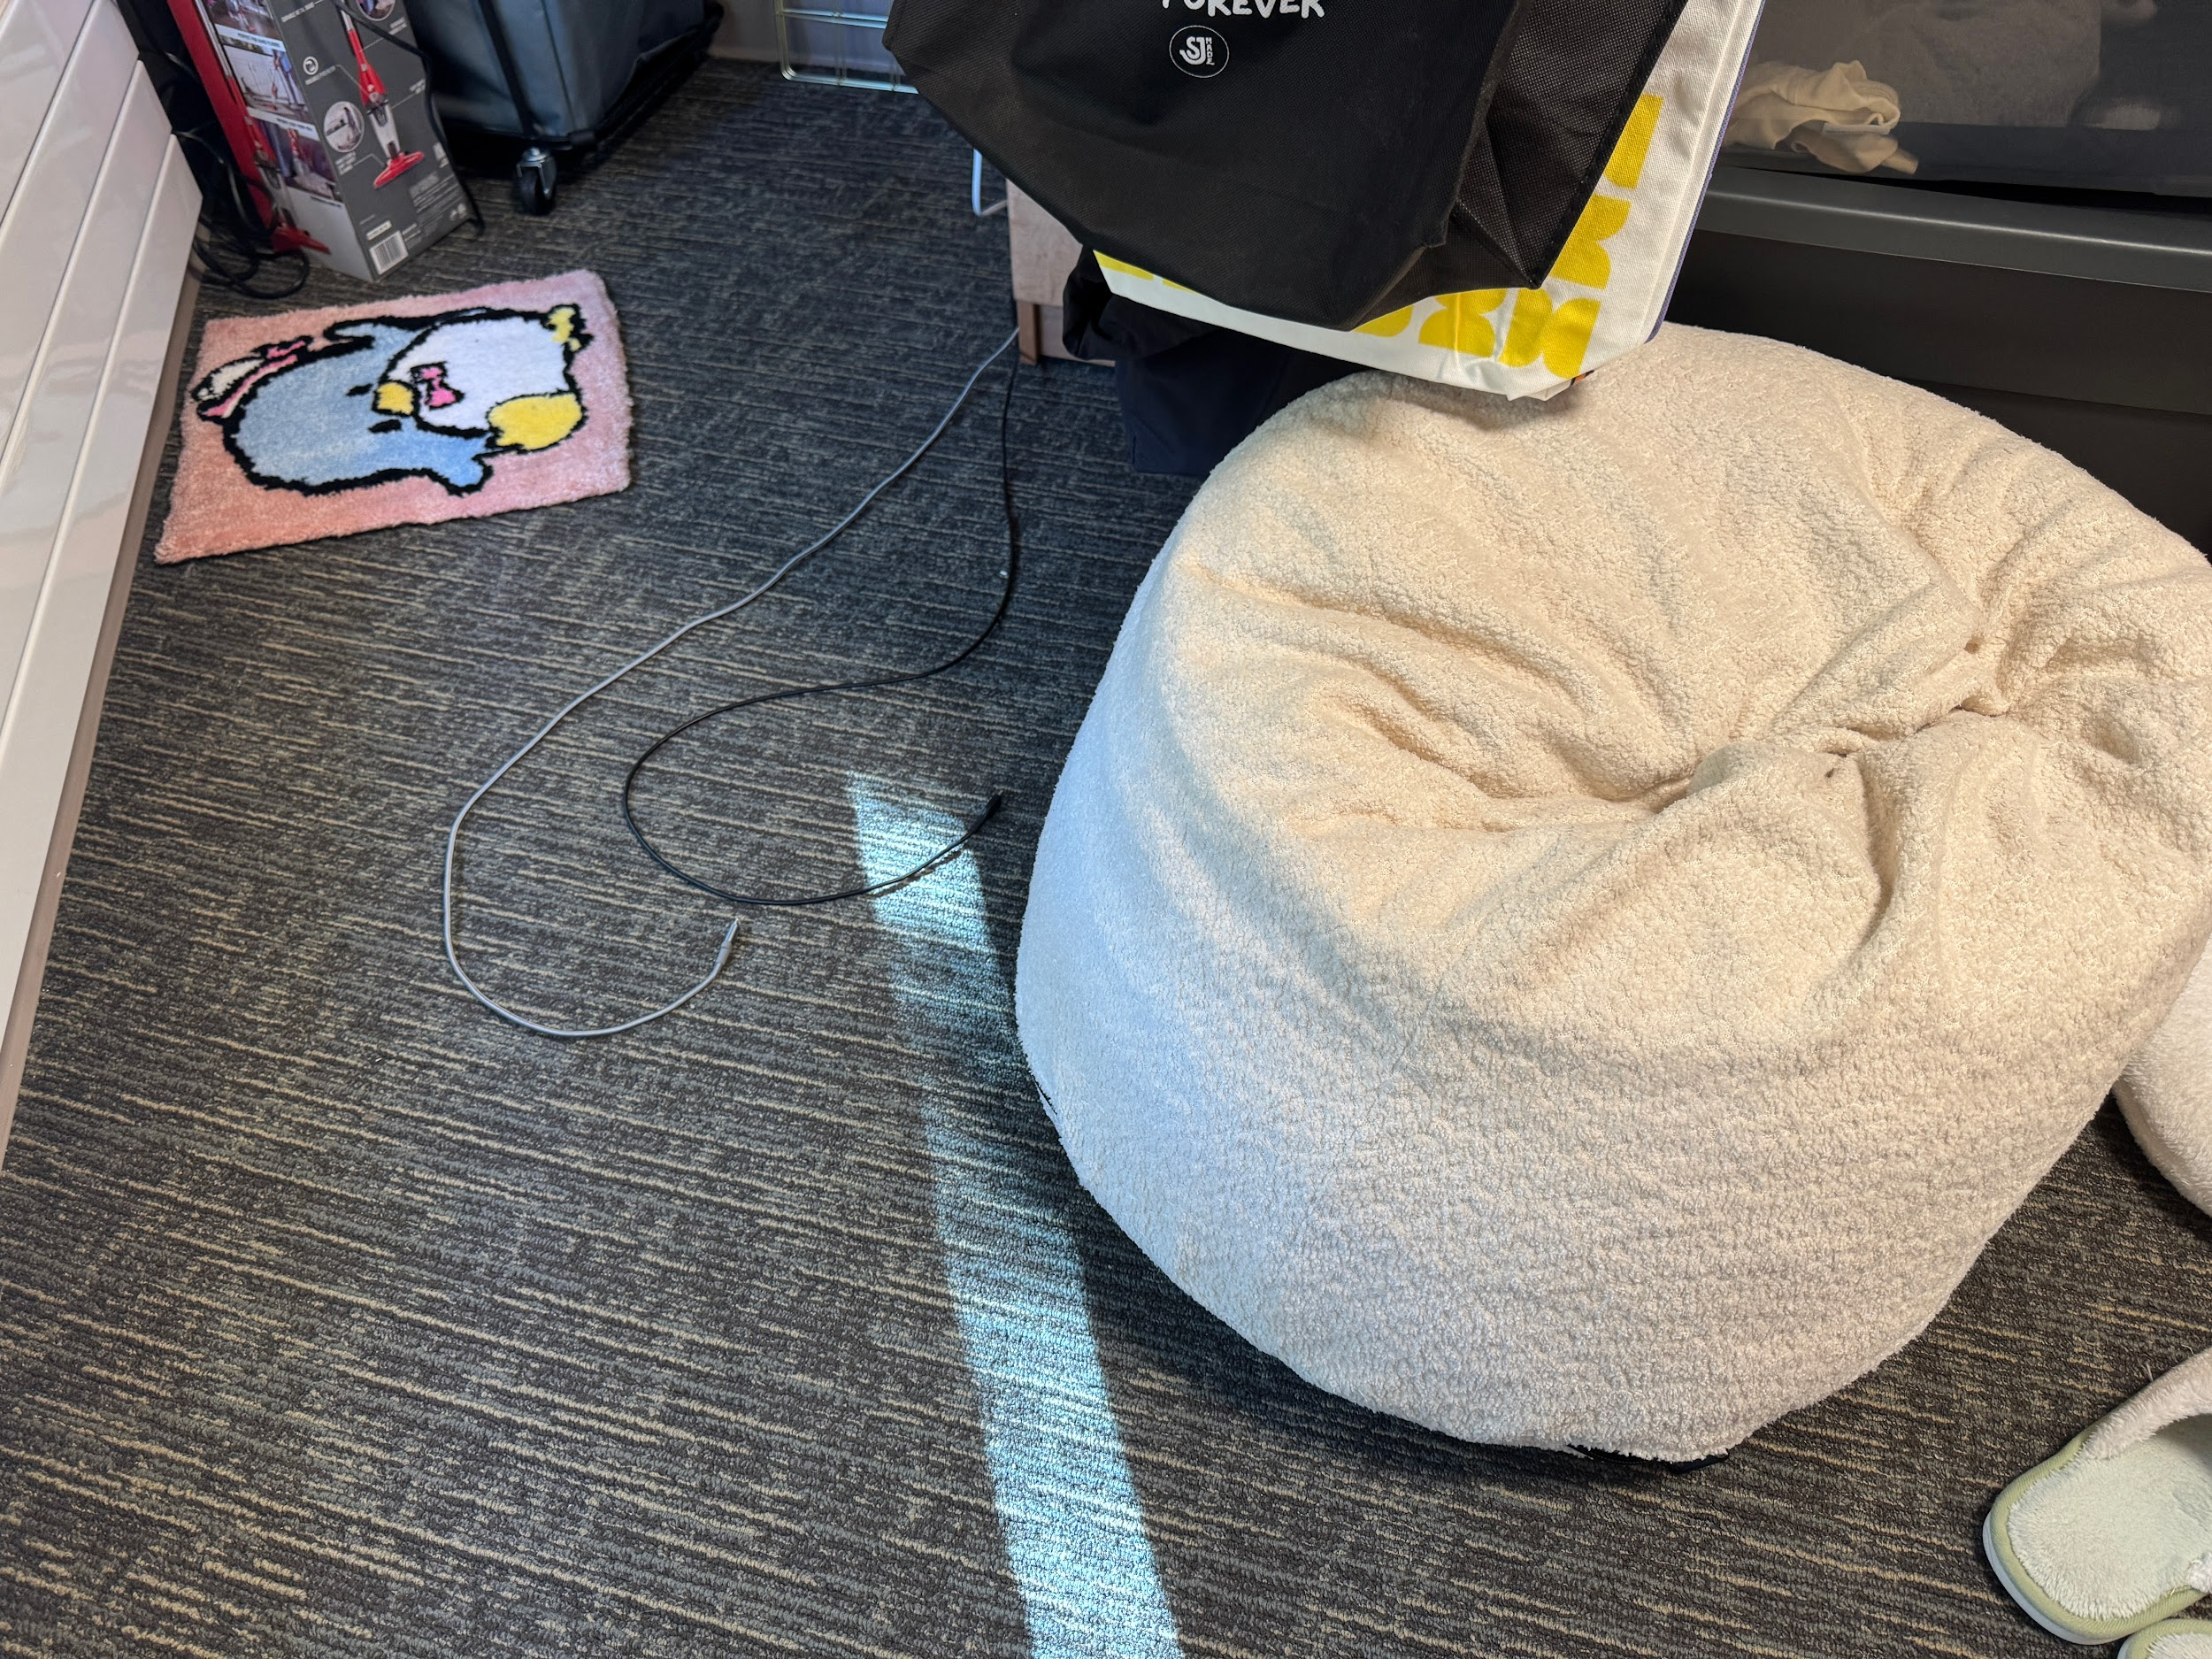
Assumption #2
Participant: Ana’s friend’s roomie (stranger)
Test: Have two strangers tell a story to another
Notes:
Environment: Semi-private area so people can’t hear what we are saying and they feel anonymous enough. Dorm room (private are)
HOW IT WAS RUN: I recorded a personal story about me almost getting fired at work.

Slide 34
Assumption #3
Seeing someone do something in a different field/career is motivating.
WHY: We wanted to understand if observing someone’s real workday could inspire people to take action toward career change or exploration. Most people read about it online or from others but don’t have the chance to visually see it themselves with the opportunity to ask questions. By asking to shadow a research lab’s project, we tested whether hands-on observation actually sparked motivation, curiosity, or confidence to try new fields themselves.
Notes:
Coffee chats

Slide 35
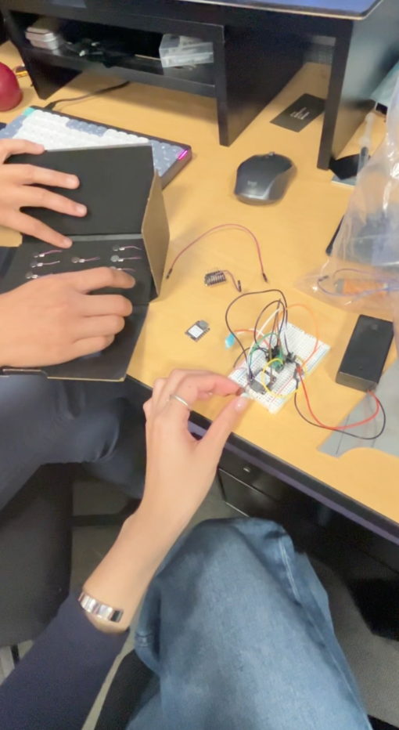
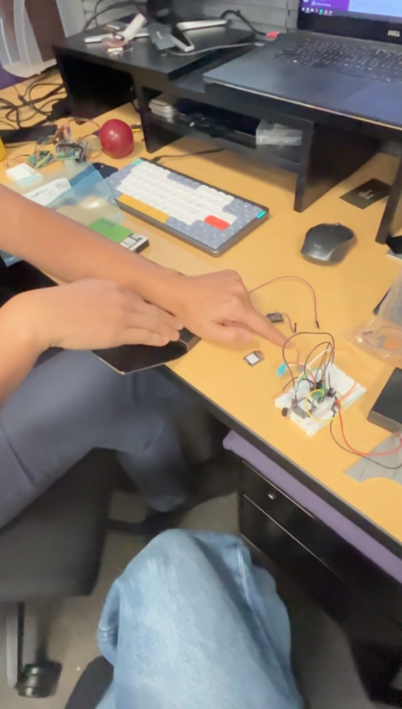
Assumption #3
Participants: Cecilia’s friend and a person from lab
Test: Ask to shadow a research lab’s project and what they are working on currently + hands on with the project
Notes:
For the prototype, we arranged a shadowing session within a research lab to allow a participant to directly observe a professional in their work setting and engage in an authentic feedback.
Roles: Person A & Person B
Environment: a lab in Mechanical Engineering (ME) building

Slide 36

“After spending time observing her in the lab, I discovered that I’m genuinely interested in this kind of work. It’s engaging, purposeful, and full of discovery.”

Slide 37
What’s next?

Slide 38
Solutions
We plan to move forward with a combination of the peer challenge system and the shadowing platform.
The peer accountability structure helps users overcome fear and hesitation.
The shadowing experience offers real exposure and insight into new fields or lifestyles.

Slide 39
Ethical Implications
Privacy and Consent: Users must feel comfortable sharing their schedules, routines, or professional environments when hosting shadow sessions.
Equity of access: Opportunities to shadow or participate in peer challenges must be distributed fairly, avoiding bias toward certain social groups or industries.

Slide 40
Who does it serve? Who might it leave out?
Serves:
  People who are transitioning from careers who are seeking for support and guidance
  Individuals wanting accountability and motivation to pursue growth opportunities.
  Those interested in experimental learning rather than traditional mentorship.
Might leave out:
  People in rural areas who have no access.
  People who are not working, such as children and elderly adults.
  Individuals in sensitive or confidential professions who cannot safely share workplace access.
  Users who are introverted or anxious about public participation and might prefer more private or passive learning options

Slide 41
Thank you!

Slide 42
Appendix

Slide 43
We met a 73-year-old man who makes audiobooks.
POVs from Studio 2 (#1)
We were surprised to realize that he doesn’t like & is not willing to read negative comments under his podcasts.
We wonder if it means he needs more encouragement and advice in a more friendly way.
It would be game-changing to help him accept those comments in a different way.
Notes:
Note: These POVs all needed to be refined, however, we didn’t select any of these and wrote 4 totally different POVs since we chose a different domain.

Slide 44
We met Finn who is a 12-year-old middle schooler from Israel.
POVs from Studio 2 (#2)
We were surprised to realize that he feels that him and his friends are targeted by some of his teachers.
We wonder if this means that Finn chooses to disengage from unwelcoming environments.
It would be game-changing to access Finn’s engagement.
Notes:
These

Slide 45
We met a 33-year-old man who is working at an AI company.
POVs from Studio 2 (#3)
We were surprised to realize that he enjoys how efficient learning can be with AI, but also don’t trust.
We wonder if this means that AI learning tools need to feel not just smart, but trustworthy and transparent.
It would be game-changing to design an AI-powered learning system that builds trust through explainability.
Notes:
These

Slide 46
We met Jake, a 21-year-old college student.
POVs from Studio 2 (#4)
We were surprised to realize that he spends 6+ hours learning every day but feels left in dark until he finds someone doing the same thing.
We wonder if this means that he learns best from sharing knowledge or receiving feedback from peers.
It would be game-changing to help him feel supportive when learning.
Notes:
These

Slide 47
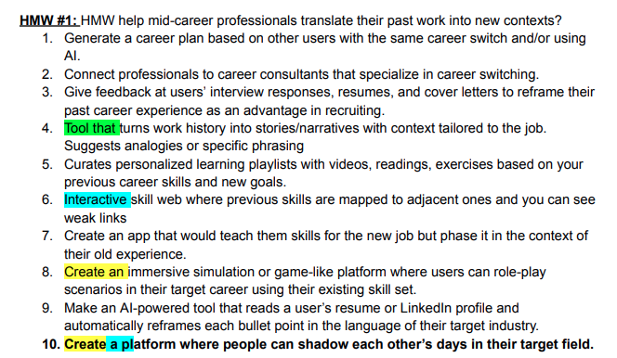
Solutions Brainstorming #1
Notes:
Note: We highlighted the ones that we liked individually using different colors, each person has 3 votes among all the HMWs. Bolded solutions are our best solutions.

Slide 48
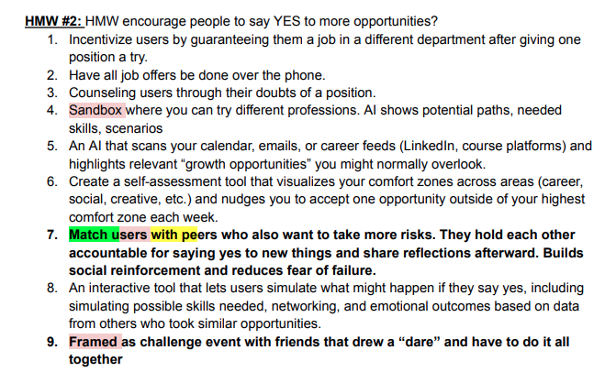

Solutions Brainstorming #2

Slide 49
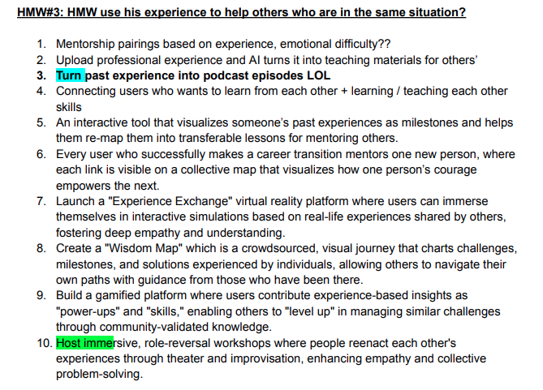
Solutions Brainstorming #3

Slide 50
Assumption 2 Full Audio: https://drive.google.com/file/d/1oqHj-hJVCzbSnNkH6PKNcZ7GGwgzJX3R/view?usp=sharing
This file includes our POV, HMW, Solutions, Results, and Ethical Implications: https://docs.google.com/document/d/1_cNkb2QEjOrBQ_cgSI1bd3bWN58rdVBaalGyy5HTC4Y/edit?tab=t.14bsce8q7n63

Slide 51
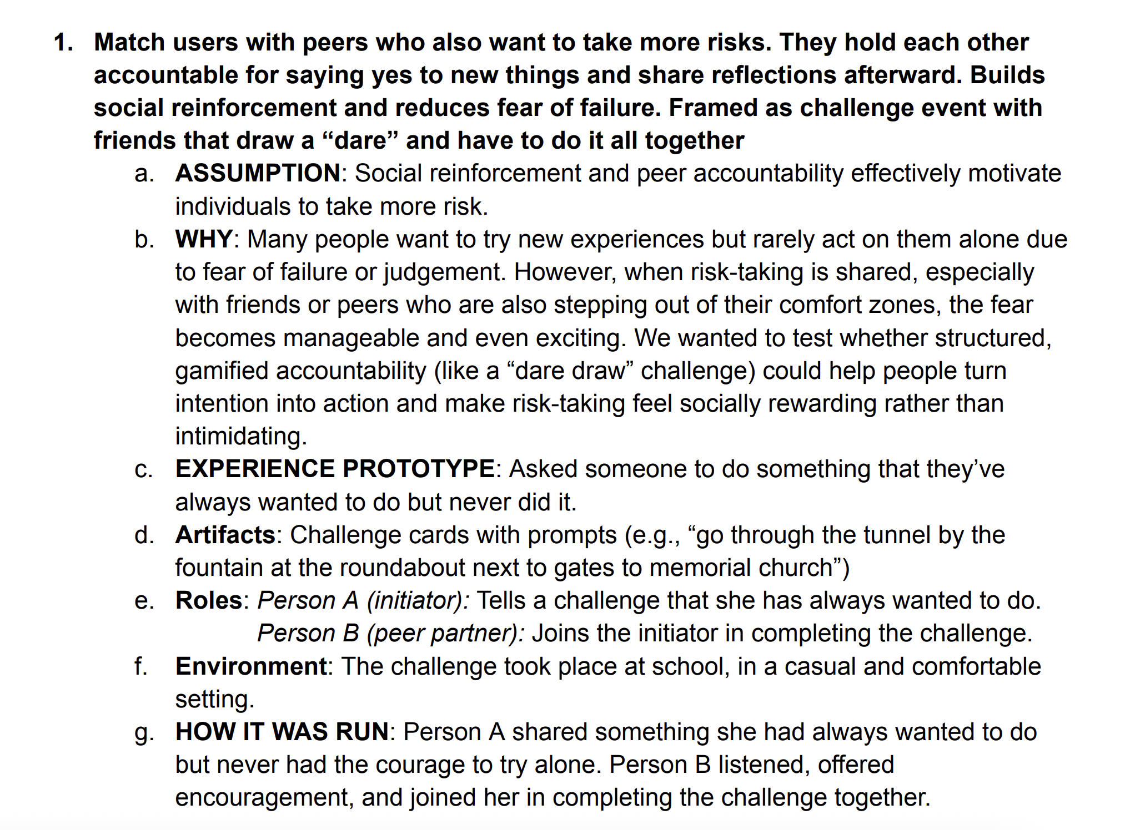
Prototype
Experience 1

Slide 52
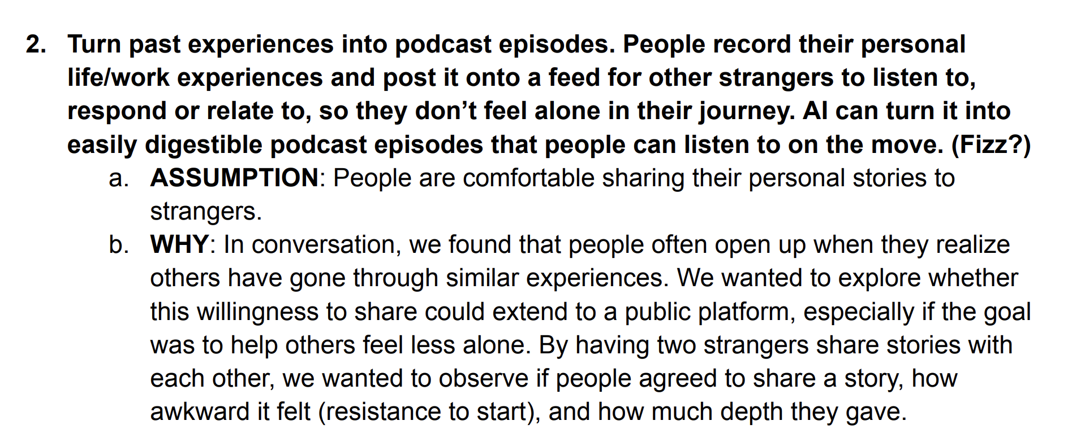
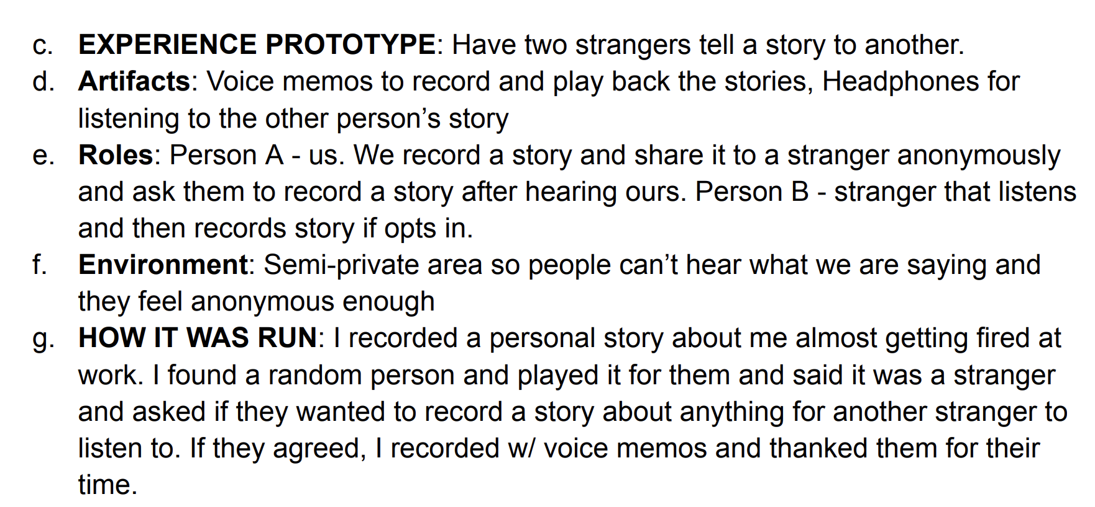
Prototype Experience 2

Slide 53
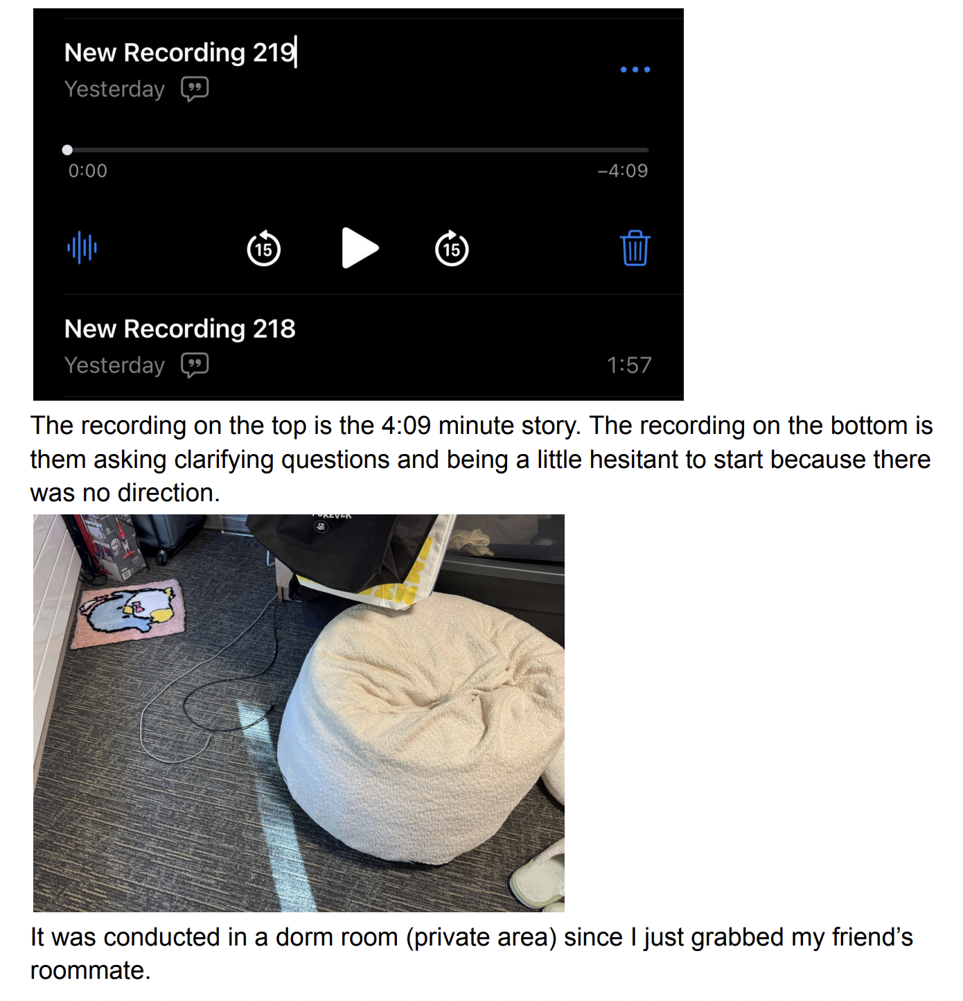
Prototype Experience 2

Slide 54
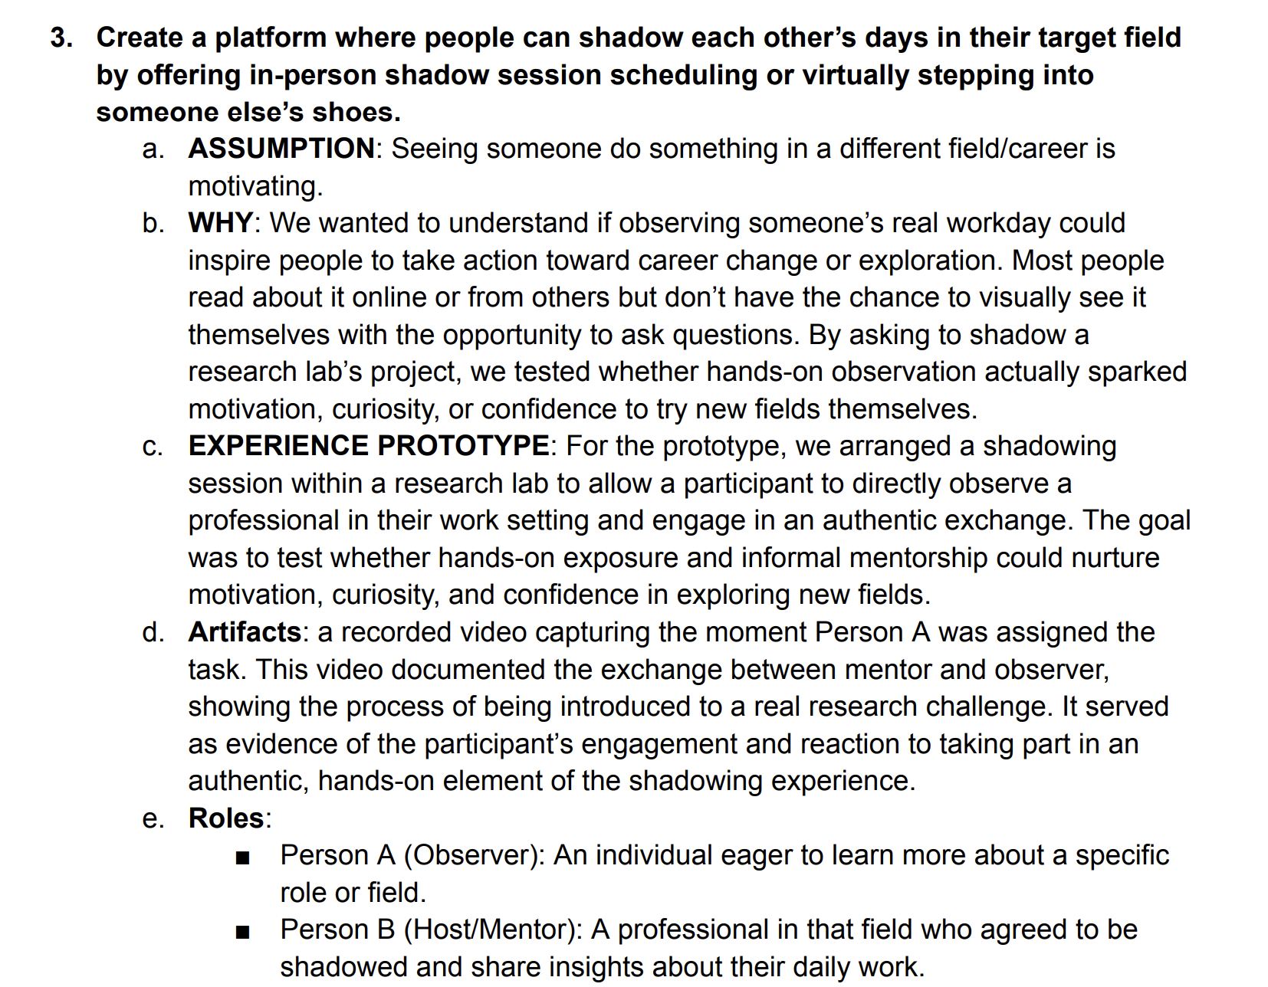
Prototype Experience 3

Slide 55
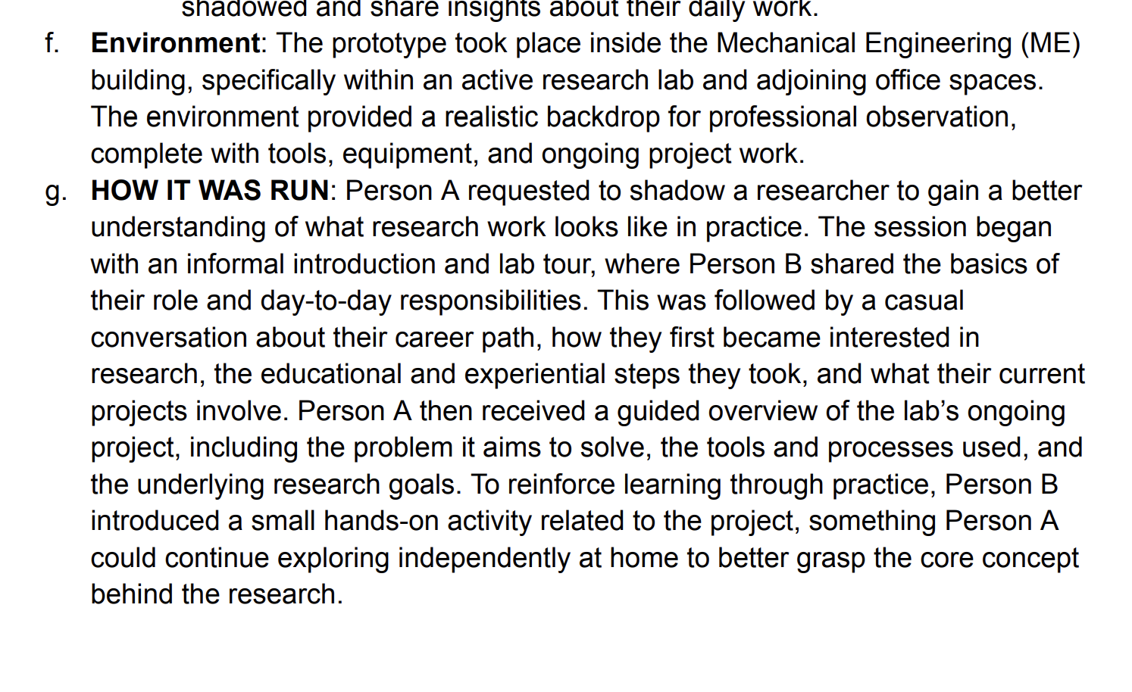
Prototype Experience 3

Slide 56
Results + Ethical Implication 1
Worked: It was amazing to see how much of a difference a little support made. The participant, who had been hesitating for a long time, finally took the leap and ended up feeling proud, relieved, and energized. Doing it together turned the whole thing from something intimidating into something exciting — more like an adventure than a challenge. She also said that having someone there to cheer her on made the experience feel less about fear and more about possibility.
Didn’t work: The problem was that the effect didn’t last. Once the moment passed, it was hard to keep that momentum going, and there wasn’t much structure to help her turn that one bold action into a pattern of behavior. Because the activity was so personal, it was also tricky to design something that would work the same way for other people.

Slide 57
Results + Ethical Implication 1
Next steps for design: Next, we could test a version where participants tackle a few challenges over time, rather than just one. We could try pairing people up with accountability buddies or small groups to build a sense of community, and maybe add simple reflection exercises so they process what they learned. That might help them keep the momentum going beyond the initial moment.
Ethical Implications/Community: Because this involves asking people to push themselves, we have to be careful about consent, safety, and emotional boundaries. Participants should always have a clear understanding of what they’re doing, feel free to stop at any time, and have support if things feel overwhelming.
What we learned: The real power of this experience came from the emotional support, not the action itself. The participant wasn’t just motivated by finally doing the thing. She was motivated by knowing someone believed in her and had her back. That shared experience was what gave her the push she needed.
Validity of the Assumption: Our assumption was only partly right. Encouragement and companionship absolutely help people overcome fear, but doing one scary thing doesn’t automatically lead to lasting change. Without more chances to reflect or keep practicing, the impact stays pretty short-term.

Slide 58
Results + Ethical Implication 1
Intended Communities: This could really benefit people in transition like those trying to make a life change, build confidence, or just shake things up. It could also help professionals who want to stretch beyond their comfort zones and grow in new ways.
Left out: We didn’t design for people who might not be able to join in easily for example, those with physical limitations or anxiety that makes risk-taking harder. In future iterations, we should explore lower-pressure or virtual alternatives so the experience is more inclusive and accessible.

Slide 59
Results + Ethical Implication 2
After a successful attempt at having two strangers tell a story to one another, we learned that although some may speak hesitantly at first, once a story starts unfolding, the speaker speaks comfortably and even shares details as impactful as concerning a car accident. In fact, we learned that our participants felt refreshed and lively after retelling a story. Further, as a team listening to our participant audios, we learned that it is convenient and productivity-sustaining to hear a story in the background of doing work.
There are an extensive amount of privacy concerns that can arise from having a platform for users to share about their careers. It is important that public users can not and should not be able to find personal details about the original poster, coworkers, company, trade secrets, etc. At the same time, if users feel that they can not talk about particular details concerning their work, motivating listeners to engage in a new career might not be very effective due to the lack of transparency.

Slide 60
Results + Ethical Implication 3
Worked: The shadowing experience successfully conveyed what a researcher’s day-to-day work entails. The participant who had no prior background in that area was able to grasp the foundational tasks and mental models of the role through guided observation and a small assigned project. Although her full reflection wasn’t recorded, she expressed genuine curiosity and excitement about trying something beyond her comfort zone. The presence of a mentor made the learning process more approachable; guidance in real time allowed her to progress with confidence rather than feeling lost in self-directed exploration. This hands-on facilitation transformed what could have been an intimidating academic environment into one that felt accessible and personal.
Didn’t work: The prototype was limited in duration, which meant the participant’s exposure only skimmed the surface of what the role entailed. While the observation sparked curiosity, it didn’t yet produce sustained motivation or deeper understanding of long-term research challenges. The experience still felt curated rather than fully immersive, which limited its authenticity as a full snapshot of professional life.

Slide 61
Results + Ethical Implication 3
Next steps for design: Next, we could extend the shadowing period to make the experience more immersive, give participants small ownership tasks to increase engagement, and include guided reflection moments to deepen learning. We could also encourage mentors to share both successes and challenges for a more authentic view, prototype remote or hybrid options to improve accessibility, and follow up later to understand the longer-term impact on participants’ interests and choices.
Ethical Implications/Community: Since it’s a short session, it's important to ensure participants are not misled by overly idealized portrayals of the profession. Mentors should be transparent about challenges, uncertainties, and failures as part of authentic career representation. Shadowing should also respect privacy, maintain informed consent, and avoid disrupting real workflows.
What we learned: We were surprised to learn that the motivation the participant gained did not come from the work’s technical content itself, but from observing the researcher’s approach to problem solving and admiring to become someone with that extensive knowledge on that object. This seems to suggest that the authentic behavior and attitude of the host / mentor seems to matter a lot, influencing how the participant would later view that subject. Even a small, low-stakes responsibility shifted her mindset from curiosity to investment.
Validity of the Assumption: Our assumption was proved to be partially valid. While observation alone does foster curiosity, without structured engagement or mentor interaction, the effect remains surface level.

Slide 62
Results + Ethical Implication 3
Intended Communities: This platform is designed for career changers, students exploring future paths, and professionals from unrelated fields seeking cross-disciplinary insight. It also benefits mentors looking to inspire and recruit new talent into their disciplines.
Left out: Individuals with disabilities that make in-person participation difficult or lack of professional connections or resources were not represented in this initial prototype. Future designs should include accessibility features for remote participation, translated materials for non-native speakers, and formats tailored to diverse learning preferences.

